Slide 1


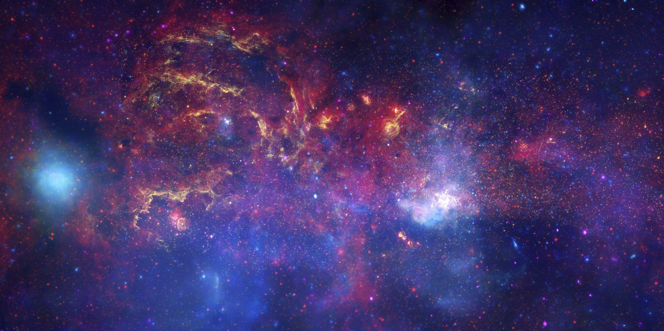
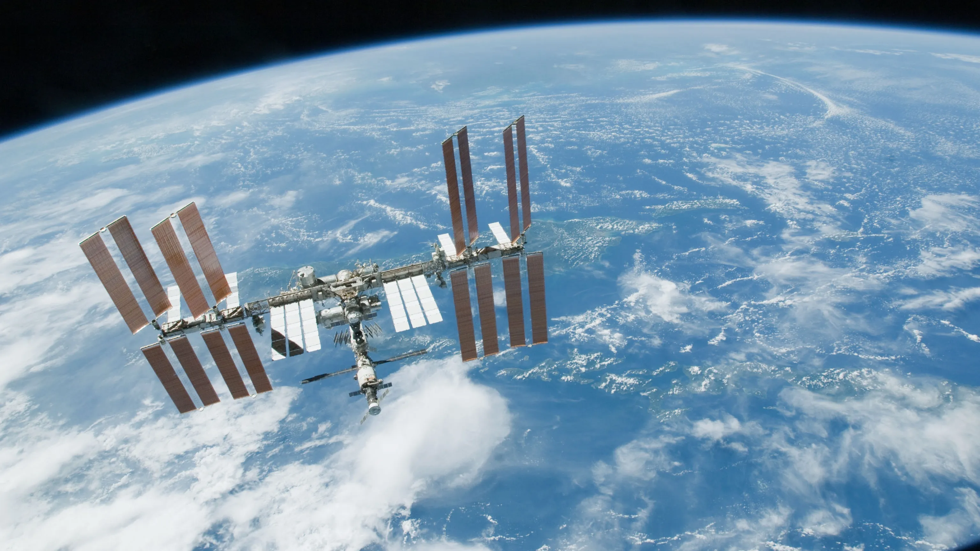
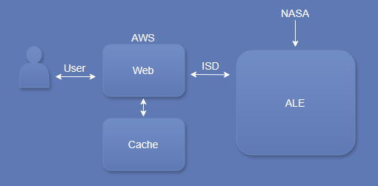



Cloud-Based Planetary Ephemerides
Team: Austin Carlile, Nicholas Gonzalez, Noah Schwartz, Minuka Trikawalagoda
Team Mentor: Scott LaRocca
Client: Christine Kim, Adam Paquette, Kelvin Rodriguez, Amy Stamile
USGS Astrogeology Center, Flagstaff, AZ
Motivation
Our Solution
Challenges
IMPROVING THE EFFICIENCY OF NASA SATELLITE DATA
The system NASA uses to search its satellite image data has a couple problems:
Cost
Performance
Time
Data size
NASA’s Spacecraft Planetary Instrument C-Matrix Events (SPICE) database is used to generate Image Support Data (ISD) which is used to match images to satellites.
The current process requires users to download large datasets (up to a terabyte) and also costs USGS upwards of $10,000 a month.
We aimed to develop a system to improve the efficiency of this process for NASA researchers.
Efficient Data Retrieval: Quick access to ISDs.
Scalability: Scaling up to 200,000 simultaneous requests.
ISD Retrieval: Generate and return ISD on demand.
Optimized Data Transfer: Minimize data size.
Queryable: Enable users to retrieve specified ISDs.
Technologies Used
ISD
Amazon ECS (EC2)
Amazon DynamoDB
FastAPI
Docker
ALE (Abstraction Layer for Ephemerides)
ISIS (Integrated Software for
Imagers and Spectrometers)
Architecture
RESTful Web Service: Fast API enables high performance, scalability, asynchronous requests, and auto-generated documentation.
Amazon Cloud Services: Our solution utilizes ECS for scalable management of high user requests, while DynamoDB reduces response times by caching ISD data.
Testing Framework: Docker ensures consistent, isolated environments for effective large dataset processing.
Solution Overview
Future Work
Our solution is a web service that generates ISDs and stores them in a caching server for quick retrieval
Web Service that generates and returns ISDs to user
Uses ALE for ISD generation
Caching Server that stores ISDs for quick retrieval
Utilizes Amazon ECS container
Our solution significantly improves research efficiency by streamlining access to NASA ISDs. USGS will expand upon it in the following ways:
Scalability: Supporting over 200,000 simultaneous ISD requests.
Dataset Growth: Expanding beyond the Viking mission to include all NASA missions.

